Slide 1
Lighthouse
By 4lgorithm

Slide 2

Agenda
Team Introduction
Demo
Methodology
Commercialisation
Vision
Questions
Photo by Juairia Islam Shefa on Unsplash

Slide 3



Meet the Team!
Aksha Amod
Data Analyst
Harry Curtis
Software Engineer
Richard Lo
Data Engineer
Gwen Santus
Software Engineer
Aya Zalzala
Data Engineer

Slide 4
DEMO

Slide 5
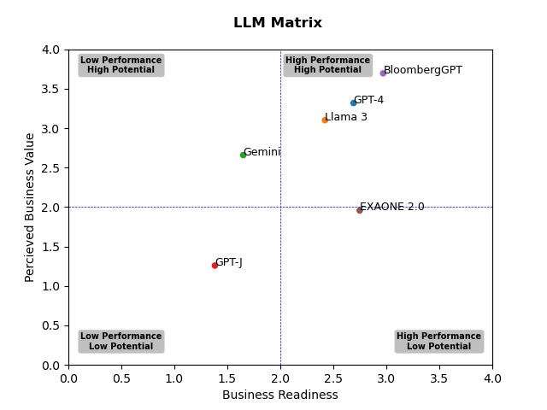
Methodology
Criteria | Weight
Business Readiness
Credibility (Reputation; Credible Reviews; Credible Mentions) | 40%
Harmfulness (Incidents; Safeguards) | 30%
Accuracy (Task Specific) | 15%
Benchmark (Average accuracy across many tasks) | 15%
Perceived Business Value
Capability (Amount of Features; How well they perform) | 50%
Success Stories (Any positive reviews) | 25%
Popularity (No. users; Growth rate; Broadness of Application) | 25%

Slide 6
Data Flow
Analysis
Data source: Stanford dataset
Situation: Cross functional teams
Solution: Data pipelines, formatting and logistics
Limitation: Extraction availability, loading constraints
Additional goal: MongoDB
Source
Json
Lighthouse

Slide 7
Vision
Short Term
Long Term
Implement database backend
Authentication for trusted members to grow the database
Ability for users to filter by industry
Internal testing for integrity
Partnership with LLM companies to distribute early access to increase exposure
We believe Lighthouse will help competing firms have faster decision making when it comes to utilising new AI technology, and additional features will help with market penetration.

Slide 8

Commercialisation
Optional subscription model
Prototype before maturity: additional resources required
Subscription to unlock features
Filtering
Sorting
API access
No adverts for integrity
Photo by Pat Whelen on Unsplash

Slide 9
Thank You!
Any Questions?

Slide 10
Appendix: Tech Stack
Plans for a MERN stack
Used Vite, React, NodeTS
Packages used: styled-components, chart.JS, chartJS-plugin-annotation.
We used these because it’s what we were used to working in, for the most part. With all the other bumps our team ran into in this project we needed the actual development to be as smooth as possible!
Chart.JS and the annotation plugin were both new and we used those as they seemed like the quickest and easiest way to get the matrix on the page.

Slide 11
Appendix: Links and Research
A more detailed Methodology
Rough research notes and links to references for individual models can be found here
Data Flow Diagram

